Slide 1

NMP Invoice Checker
[Please select]
Optimized invoice control through ML
08/05/2025
Elia Landini
PRE/Corporate Real Estate

Slide 2

BUSINESS CASE
The ECB manages an extensive and complex real estate portfolio across multiple jurisdictions. Periodically the respective property managers provide a control sheet presenting a global overview of the respective invoices that has been processed throughout the reference period. The CRE team is in charge of initiating the verification workflow and this latter has historically been handled manually, depending on the approach of individual property managers.

Slide 3



PROJECT-OVERVIEW
OBJECTIVES
KEY FEATURES
The NMP Invoice Checker is a semi-automated, Streamlit-based application built to improve how the European Central Bank (ECB) verifies invoices within its vast real estate portfolio.
Automate invoice validation using rule-based logic and text processing
Reduce human error and ensure high accuracy in invoice reconciliation
Improve operational efficiency and handling time for CRE
Upload control files (.xlsx/.csv)
Extract & tokenize text from PDF and scanned invoices
Match invoice content to control datasets
Provide validation dashboards

Slide 4

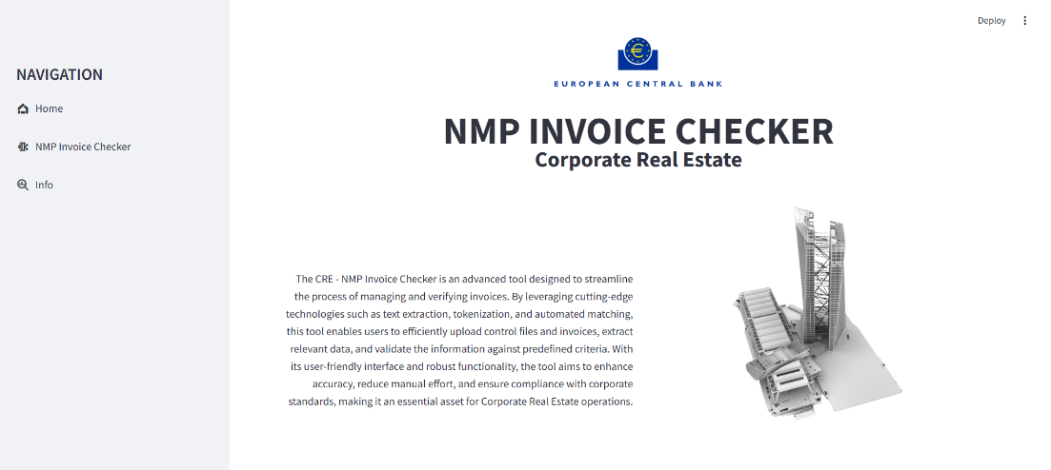
ARCHITECTURE & TECHNOLOGY
Technology Stack:
Frontend/UI: Streamlit
Text Extraction: PyPDF2, EasyOCR
Data Handling: pandas, NumPy
Text Processing: NLTK (lemmatization, stopwords)
OCR Optimization: Language-specific text extraction (EN, FR, DE)
Design:
Modular architecture with four chapters: Upload Control File, Upload Invoices, Verification, Validation

Slide 5
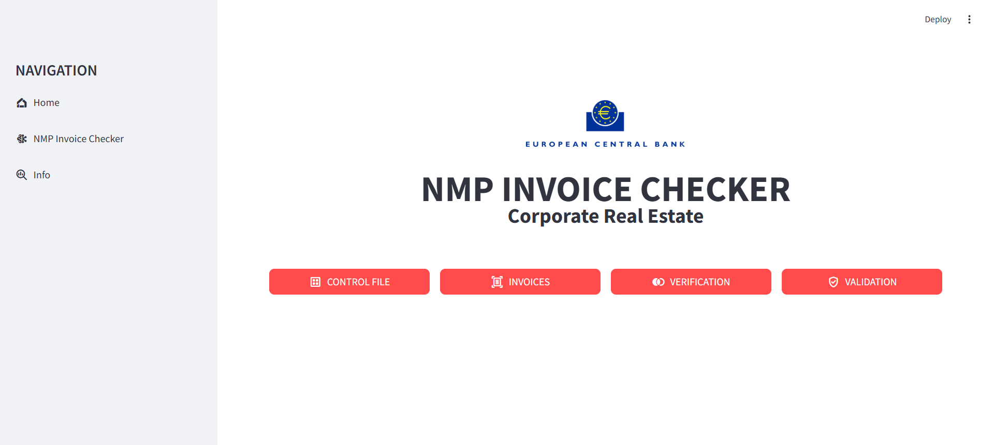
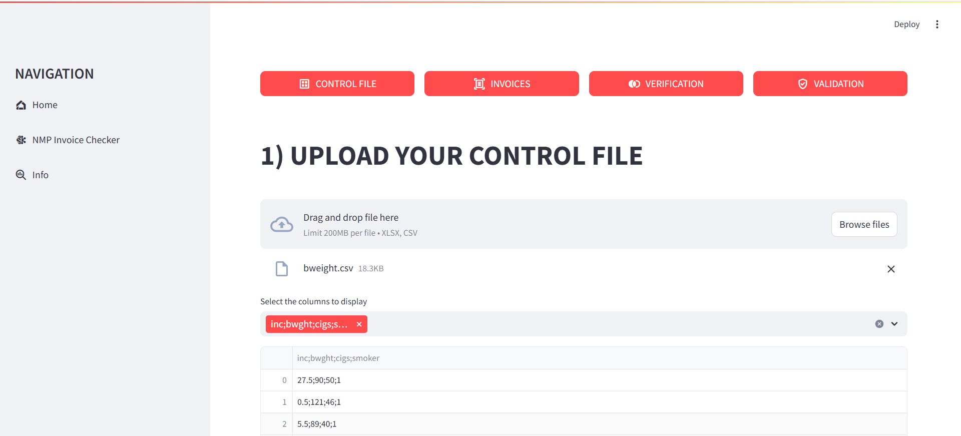


KEY FUNCTIONALITIES
Structure:
4 isolated session states modules
Each module preserves the output locally in order to avoid heavy reruns triggered by each interaction with UI elements
Upload Control File:
Accepts .xlsx or .csv
Displays selected columns

Slide 6
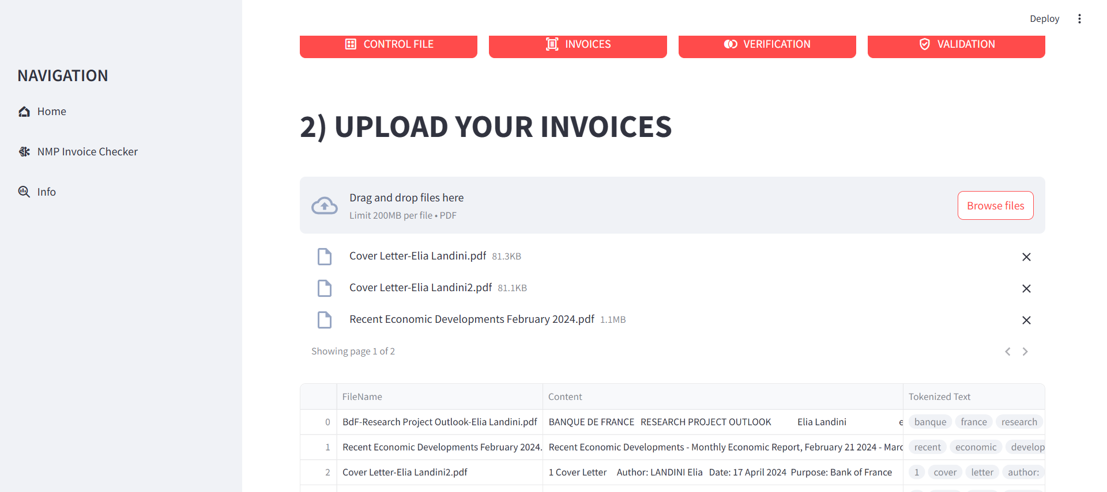
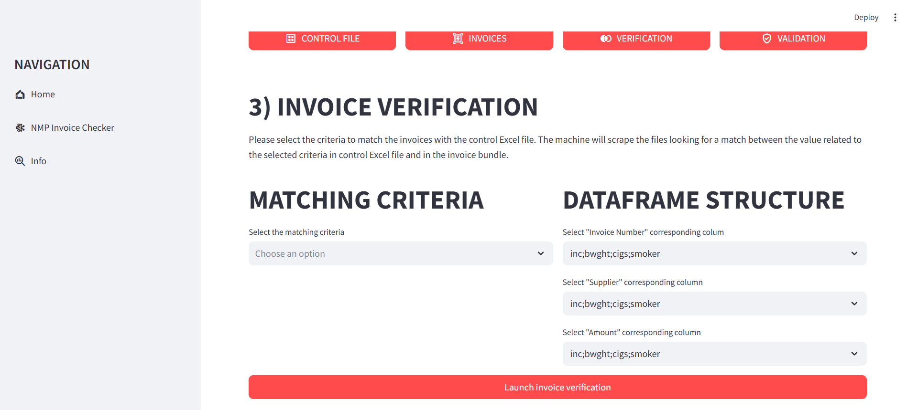


KEY FUNCTIONALITIES
Upload Invoices:
Accepts multiple PDFs
Extracts text using PyPDF2 or EasyOCR fallback
Tokenizes invoice text to isolate relevant terms according to tailor-made parameters
Filters out multi-language stopwords
Verification Module:
User-defined matching criteria (e.g., Supplier, Amount, Invoice ID)
Tokenized comparison with control file

Slide 7


FUTURE ENHANCEMENTS
Operational Gains:
Up to 80% reduction in manual effort
Faster processing with greater consistency
Scalable tool usable across departments
Potential Upgrades:
Add AI-based anomaly detection for outliers or suspicious invoices
Enable feedback loop for continuous learning from validations though human feedback
Deploy it on either VM or through .exe file
Dashboard integrations with Power BI or SAP modules for reporting

